Slide 1

Fluid: Resource-aware Hyperparameter Tuning Engine
Peifeng Yu†, Jiachen Liu†, Mosharaf Chowdhury
† Equal contribution

Slide 2
Outline
1. Background and Motivation
2. Abstraction and Algorithms
3. Evaluation

Slide 3
Hyperparameter Tuning Today
Hyperparameters
# of layers/# of neurons
Dropout rate
# of channels
Learning rate
Optimizer parameters
Etc.
Non-differentiable & high dimensional search space
Notes:
Let’s start with a brief intro of HP tuning today
What are HPs? ….
There are lots of them, each with certain kind of range, and we want to find the best set for training,
So HP tuning is a search problem
Search space is … & …

Slide 4
Hyperparameter Tuning Today
Evaluation of hyperparameters is time/resource consuming
train a model to know if it works
Many algorithms & techniques
Random/Grid
Model-based config generation
Early stopping/successive halving
Many others
Notes:
And, how do we evaluate a set of hp config? We train a model and see if it works well.
That’s both time/res consuming
So naturally there are lots of algo & tech to make the process as efficient as possible
We have the very basic random/grid
More advanced model-based
Other techniques like early stopping, including the well known one successive halving

Slide 5
Hyperparameter Tuning Today
Hyperparameter Tuning Algorithm
Config Generation
3




trials
1
4
2
Evaluation
Notes:
How exactly does the tuning process work? Here’s a simple illustration
One the left is a box representing a tuning algorithm, and on the right, a cluster.
The algorithm generates bunch of hyperparameter configs
These are sent to the eval logic, which decides which config to evaluate next
And give it to the cluster to run, in the form of a training trial.
When trials finish, the result is propagated back,
Which may be used to guide future generations, like Bayesian optimization
That’s the whole picture, and as we can see, the topic of our talk today, trial execution …

Slide 6
Hyperparameter Tuning Today
Hyperparameter Tuning Algorithm
Config Generation
3




trials
1
4
2
& Execution
Evaluation
Direct interaction with the cluster to execute trials
Trials gets executed in FIFO order
Notes:
… trial execution, is merely a thing that is implicitly defined by the evaluation logic,
In other words, it’s the algo’s solo responsibility to directly instruct the cluster for trial execution.
In most cases, tuning algos do no more than a simple FIFO queue, and forget about it

Slide 7
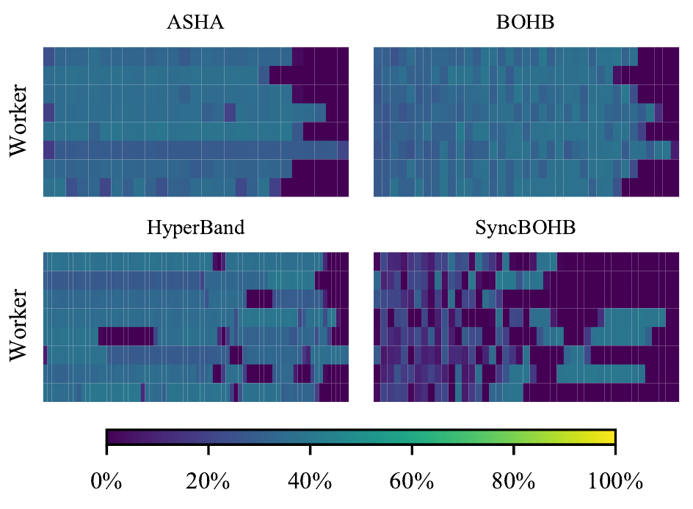
Trials Execution
Time
Time
Time
Time
Notes:
However, trial execution is not a trivial problem, at all.
Let me show you a GPU utilization heat map of 4 algo tuning a classification model.
Under our measurement, the avg util is in the range of 20-40%, which is far less than ideal.
We can’t really blame the algorithms, though, as there are actually some tricky parts in the execution that could be easily overlooked.

Slide 8
Trials Execution
Lack of elasticity reduces utilization
Existing trials can not easily use new idle workers
High utilization != useful work
Asynchronous Successive Halving (ASHA)
Trial concurrency == # of workers
Can not scale up beyond a certain # of workers
Yet another hyperparameter tuning algorithm?
Notes:
There are some tricky parts in the execution that could be easily overlooked.
First, most tuning framework defaults to single trial single worker setup, or at most allow distributed training via some custom settings. In either case, the number of workers is statically set, and can’t be changed during runtime
Second, high util doesn’t equal to useful work. For example, in ASHA, there’s always the same number of trials running as the # of workers, by starting new base stage trials whenever there’s an idle worker.
This certainly helps improve the utilization, but beyond a certain point, adding more workers doesn’t speed up the algorithm anymore. Because those extra workers are busy computing trials from the base stage, and those trials are likely
Never used for the final goal.
Now we know some of the tricky details, we can simply come up with “yet another HP tuning algorithm”

Slide 9
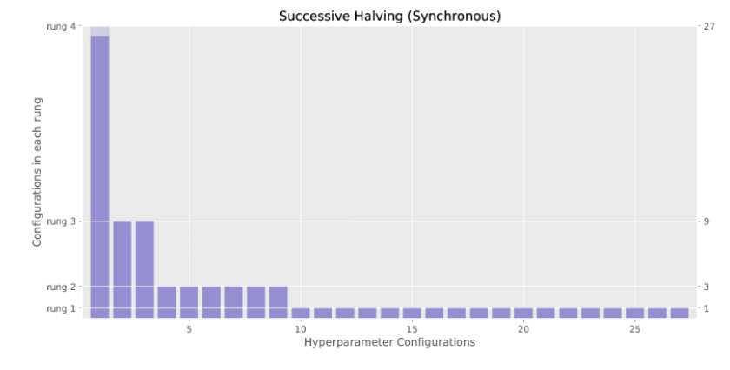
Case Study: Lack of Elasticity Reduces Util.
Successive Halving (SHA)
# of workers is static
Each trial uses one worker
# of trials is diminishing
# Workers | Utilization | Runtime(s)
2 | 81.2% | 2356
4 | 63.0% | 1432
8 | 45.8% | 1073
16 | 47.0% | 475
32 | 25.2% | 432
Utilization of Successive Halving (Synchronous)
Right figure by: Liam Li, https://blog.ml.cmu.edu/2018/12/12/massively-parallel-hyperparameter-optimization/
Notes:
In this case study, we are tuning a simple classification model using synchronous SHA
We assume # worker is static, each trial uses exactly one worker
As shown in the left figure, there will be 4 stages, where each stage will choose the best one third of its previous stage’s trials and spend more resources on them
So # of trials is diminishing
It’s already clear from the figure that there aren’t enough trials to keep workers busy at later stages of the algorithm,
And quantitively, this table shows the avg util given different # of workers.
It’s obvious that the lack of elasticity is the problem. If distributed training were used, and training trials can be elastically scale up when there are idle workers, it will greatly improve the utilization.

Slide 10
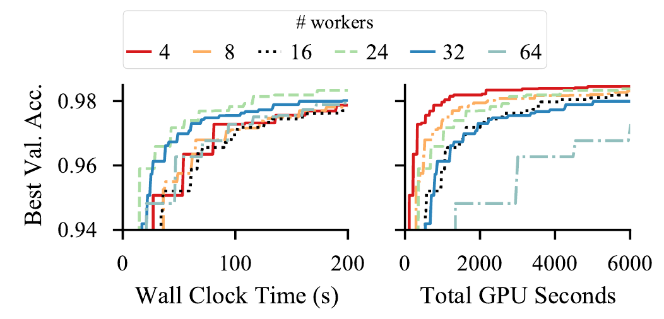
Case Study: High Utilization != Useful Work
Simply way to parallelize: always ensure enough trials to saturate the cluster
Asynchronous SHA (ASHA): trial concurrency == # of workers
Can not scale up beyond a certain # of workers
Notes:
Ok, that’s just a naïve way to implement the algo, you may say, we can easily increase the # of trials to saturate the cluster, without the hassle of elastic distributed training
That’s the technique used in ASHA, async SHA. Which is similar to SHA, but keeps adding new trials to the base stage, as long as there are idle workers.
So there are always n trials running given n workers.
We track the best val. acc over wall clock time & GPU sec
Beyond a certain point, adding more workers doesn’t speed up the algorithm anymore,
and even though the cluster is still fully utilized, those busy workers are not doing anything useful toward the end goal

Slide 11
Trials Execution
What about existing algorithms?
Mostly still FIFO
Execution is tightly coupled with algorithm
Hard to apply to other algorithms
Hard to improve w/o deep knowledge of the algorithm itself
Notes:
But that does not help with whole ecosystem as a whole very much: most wildly used algorithms still use FIFO
The more fundamental problem is that the execution is still tightly coupled with algorithm
What else can we do?

Slide 12
All problems in computer science can be solved by another level of indirection
--- Butler Lampson
Notes:
As the saying goes

Slide 13
Hyperparameter Execution Engine: Fluid
Hyperparameter Tuning Algorithm
Config Generation




trials
Evaluation
Execution
&
Notes:
That is basically what we did:
Recall how HP tuning algorithms work, and how they directly talk to the cluster,

Slide 14
Hyperparameter Execution Engine: Fluid
Hyperparameter Tuning Algorithm
Config Generation




Execution
Evaluation
Notes:
we extract the execution logic and build a dedicated engine that’s specialized to run trials as efficient as possible.
This abstraction layer will handle all trial execution requests for HP tuning algorithms.
Inter-GPU: elastic distributed training
Intra-GPU: Nvidia MPS

Slide 15
Hyperparameter Execution Engine: Fluid
Hyperparameter Tuning Algorithm
Fluid
Config Generation




Evaluation
Wide variety of tuning algorithms
Random/Iterative/Sequential
TrialGroup
Heterogeneity & dynamicity
Multiple source of parallelism
Inter-GPU: elastic distributed training
Intra-GPU: Nvidia MPS
StaticFluid/DynamicFluid
Notes:
we extract the execution logic and build a dedicated engine that’s specialized to run trials as efficient as possible.
One the one hand, this abstraction layer will handle all trial execution requests for HP tuning algorithms. There are wide variety of tuning algorithms, each with …/../…
Fluid uses a concept called TrialGroup to capture all these uniformly, providing a consistent model for later scheduling.
On the other hand, Fluid has to handle heterogeneity and dynamicity from the cluster and inherently in trial execution itself.
For example, different hyperparameter configuration may change the model structure, and thus changing its training runtime, or the cluster resource may be added or removed at any time.
In Fluid, we use the state-of-art techniques to exploit both the inter and intra-GPU parallelism, to make best use of the cluster resources,
and we develop algorithms firstly cover the offline setting and extend it to more complex online settings.
To summerize, Fluid answers the question about where and when to run trials on the cluster. As for *how* Fluid does this, I’ll leave the next part to Jiachen.

Slide 16
Goals
Challenges
State-of-the-art resource efficiency
Inter-GPU: distributed training
Intra-GPU: Nvidia MPS
Apply to most tuning algorithms
React to cluster resource changes
The wide variety of algorithms
Algorithm-awareness
Dynamic environment
Trial add & removal
Resources add & removal
Heterogeneity in trial profiles
Nonpredictable iteration time
Notes:
With Fluid, we want to achieve the following goals,
1.
2.
3.
Given these goals, it’s not a trivial task to build such an engine
First of all, … makes it hard to maintain algo-awareness, such that we can still make decisions based on rich algorithm level info
Second, both trials and res can be added & removed at any time, making resource planning challenging
Last, HP may change the structure of the model, so the training iteration time can’t be easily predicted, and we basically have a heterogeneous bag of trial to schedule
So let’s welcome Jiachen. She will introduce the TrialGroup abstraction and how our algorithm solve the challenges.

Slide 17
Resource Parallelism
1. Intuition: More trials than resources
Intra-GPU parallelism: NVIDIA MPS
2. Intuition : More resources than trials
Inter-GPU parallelism: distributed training/elastic resource
How to account for overhead ?
Marginal benefit assessment
Notes:
How fluid execute these trial groups to achieve higher performance is through leveraging parallelism

Slide 18
Outline
1. Background and Motivation
2. Abstraction and Algorithms
3. Evaluation
Notes:
She’ll discuss in detail the TrialGroup abstraction and our algorithms.

Slide 19
The Interface: TrialGroup
Definition:
A group of training trials with a training budget associated to each trial.
Definition
A group of training trials with a training budget associated to each trial.
Example
Given 5 trials to evaluate:
Grid/random search:
Sequential model-based algorithms:
x5
One TrialGroup
Notes:
We propose an abstraction: TrialGroup, which enables fluid to execute all hp algo
Sequentially evaluate the trials and optimize the search space.

Slide 20
The Interface: TrialGroup
Definition:
A group of training trials with a training budget associated to each trial.
Generalization:
All kinds of hyperparameter tuning algorithms could be expressed by
a sequence of TrialGroup and executed by Fluid.
Definition
A group of training trials with a training budget associated to each trial.
Generalization
All kinds of hyperparameter tuning algorithms could be expressed by a sequence of TrialGroup and executed by Fluid.
Notes:
After abstracting all kinds of hp algo by trialgroup,
Next goal is to minimize the makespan … and maximize the resource utilization

Slide 21
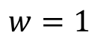
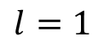
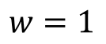
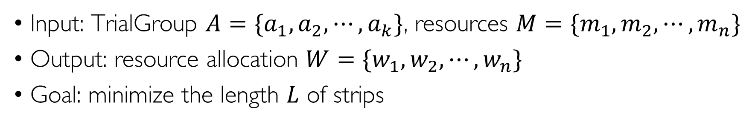
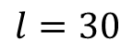
Problem Definition: Strip Packing
Input: TrialGroup $A=\{a_{1},a_{2},⋯,a_{k}\}$, resources $M=\{m_{1},m_{2},⋯,m_{n}\}$
Output: resource allocation $W=\{w_{1},w_{2},⋯,w_{n}\}$
Goal: minimize the length $L$ of strips
$$w=1$$
$$l=30$$
$$w=1$$
$$l=1$$
Notes:
Start with minimizing the makespan of a single trialgroup
, we formularize the problem
For each trial , you can choose to

Slide 22
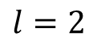
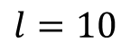
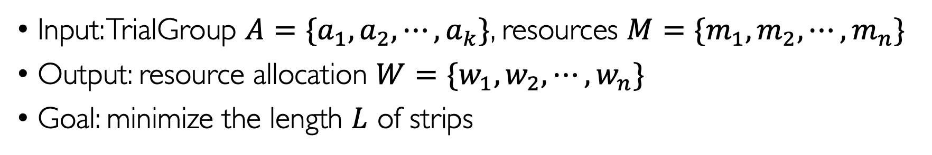
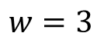
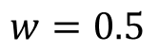
Problem Definition: Strip Packing
Input: TrialGroup $A=\{a_{1},a_{2},⋯,a_{k}\}$, resources $M=\{m_{1},m_{2},⋯,m_{n}\}$
Output: resource allocation $W=\{w_{1},w_{2},⋯,w_{n}\}$
Goal: minimize the length $L$ of strips
$$w=1$$
$$w=3$$
Inter-GPU
$$l=30$$
$$l=10$$
$$w=1$$
$$w=0.5$$
Intra-GPU
$$l=1$$
$$l=2$$
Notes:
when to use

Slide 23
Toy Example
1
a₁
4
a₁
a₁
a₃
a₂
2
a₂
4
a₂
a₃
12
Worker
3
a₃
12
4
a₄
30
a₄
10
a₄
10
5
Default
Optimal
Fluid
Different solutions to execute 4 trials (1 TrialGroup) scheduled on 5 workers
Fully utilize the resources and mitigate the straggler
Notes:
Hard to achieve optimal solution
A1,a2 use MPS packing
A4 use distributed training

Slide 24
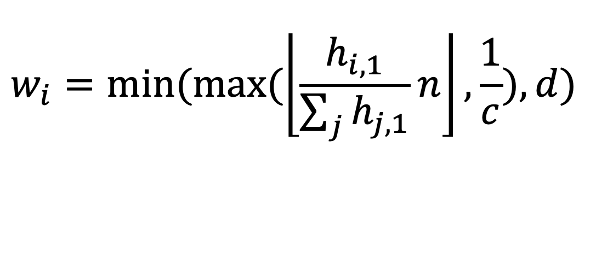
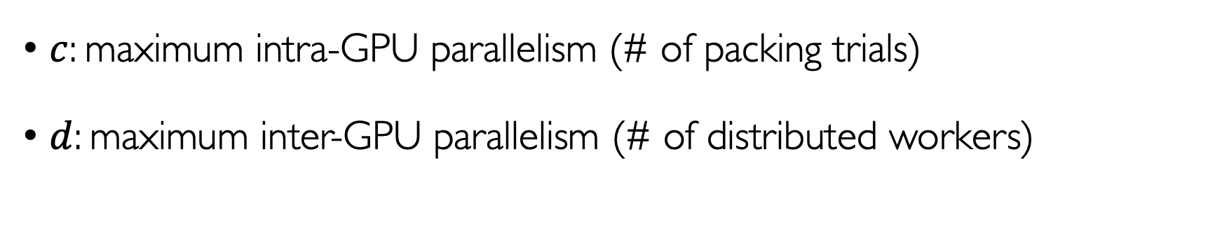
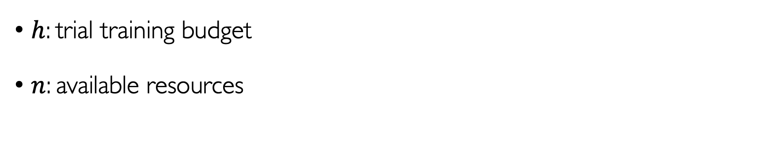
Algorithm: StaticFluid
Intra-GPU overhead
$$w_{i}=min⁡(max⁡(\left\lfloor \frac{h_{i,1}}{\sum_{j}{h_{j,1}}}n\right\rfloor ,\frac{1}{c}),d)$$
$h$: trial training budget
$n$: available resources
Inter-GPU overhead
Budget ratio
$c$: maximum intra-GPU parallelism (# of packing trials)
$d$: maximum inter-GPU parallelism (# of distributed workers)

Slide 25
Algorithm: DynamicFluid
$$w_{i}=min⁡(max⁡(\left\lfloor \frac{h_{i,1}}{\sum_{j}{h_{j,1}}}n\right\rfloor ,\frac{1}{c}),d)$$
Minimize the makespan of multiple TrialGroups
Dynamically changing resources
Notes:
Even difficult
Refer to paper

Slide 26
Outline
1. Background and Motivation
2. Abstraction and Algorithms
3. Evaluation

Slide 27
Evaluation Setup
Implementation: an alternative Ray^{[1]} executor
Workloads
Task | Base Model | # of Params. | Target
CIFAR-10 | AlexNet | 7 | Acc. >= 90%
WLM | RNN | 10 | PPL <= 140
DCGAN | CNN | 2 | Inception >= 5.2
[1]: https://github.com/ray-project/ray
Notes:
We evaluate fluid using
ray

Slide 28
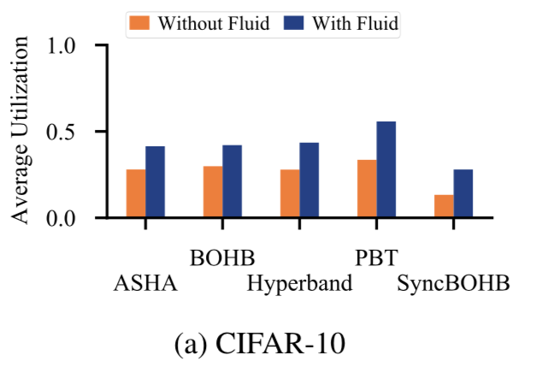
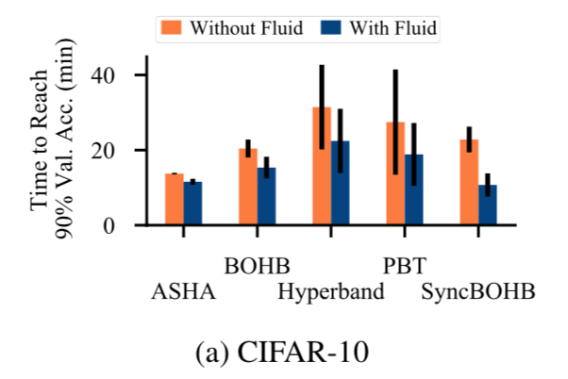
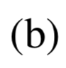
Evaluation Results
Average resource utilization: 10%-100% improvement
Average job completion time: 10%-70% improvement
Notes:
Fluid has gain on all cases
In summary

Slide 29
Evaluation Results: Visualization
Resource utilization over time
Time
Time
Time
Time

Slide 30
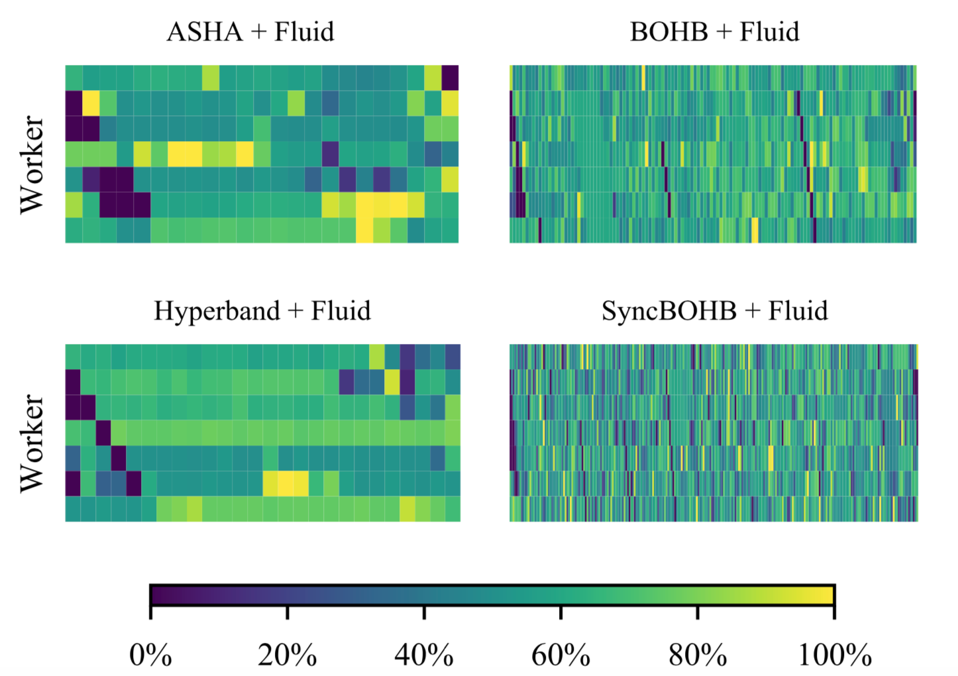
Evaluation Results: Visualization
Resource utilization over time
Time
Time
Time
Time

Slide 31
Conclusion
Fluid
Hyperparameter tuning execution engine
Can be combined with most tuning algorithms
Improve utilization and end-to-end tuning time
Open source
https://github.com/SymbioticLab/fluid
Q&A
Notes:
Doesn’t require any changes from algorithm and resource setup

